Slide 1
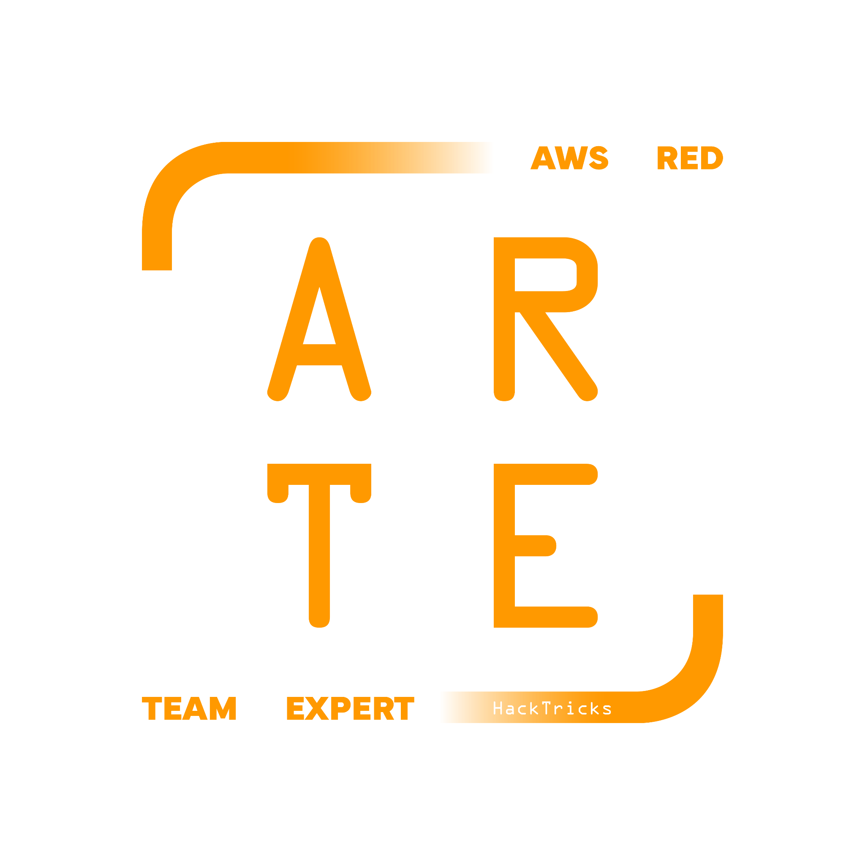
AWS Principals
HackTricks Training
https://t.me/CyberFreeCourses

Slide 2
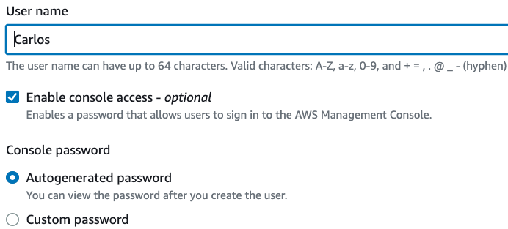
IAM - Users
DEMO
Represents the a or application that interacts with AWS
Username + Password
API token (max 2 per user)
Both
Each AWS account will have a Root user. This is the most powerful user in the account.
In orgs it’s recommended to deactivate root users of children accounts (using SCPs) and leave only the root user of the root account
Root users should only be used if there is no other option to recover the account or give a permission
https://t.me/CyberFreeCourses
From https://cloud.hacktricks.xyz/pentesting-cloud/aws-pentesting/aws-basic-information#id_iam-users
Notes:
DEMO: Create a user from the console

Slide 3
IAM - MFA
Policies with MFA conditions can be attached to the following:
An IAM user or group
A resource such as an Amazon S3 bucket, Amazon SQS queue, or Amazon SNS topic
The trust policy of an IAM role that can be assumed by a user
It’s possible to check
Existence - "Condition": {"Bool": {"aws:MultiFactorAuthPresent": "true"}}
Duration
MFA can be enabled for password authentication & cli
aws sts get-session-token --serial-number <arn_device> --token-code <code>
Useful to limit permissions of CLI creds, but not always possible
MFA is commonly used to access the console
But not very used to restrict CLI access
https://t.me/CyberFreeCourses
https://cloud.hacktricks.xyz/pentesting-cloud/aws-pentesting/aws-basic-information#mfa-multi-factor-authentication

Slide 4
IAM - User Groups
Only users (not groups or roles) can be part of a group
Policies attached to groups are inherited by users
Groups cannot be granted permissions inside a policy
No AssumeRole permission to a group
Recommended way to group users and assign them permissions
https://t.me/CyberFreeCourses
From https://cloud.hacktricks.xyz/pentesting-cloud/aws-pentesting/aws-basic-information#id_iam-groups

Slide 5
IAM - Roles
Similar to a user but without credentials associated
Can be accessed only through other principals (users, federated, other roles…)
Each role has a trust policy that indicates who can access it - This is ALWAYS a requirement to assume the role
The account of the ppal doesn’t always need to allow it to assume a role to be able to assume it (more on this on the STS chapter).
Credentials are temporary (session token)
https://t.me/CyberFreeCourses
From https://cloud.hacktricks.xyz/pentesting-cloud/aws-pentesting/aws-basic-information#id_iam-roles

Slide 6
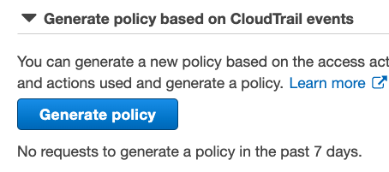
IAM - Boundaries & Least Privilege Principle
Limit permissions a specific user might have
Even if the user has Administrator access, if the boundary indicates just read buckets, he will only be able to read buckets
Only users can have them (not roles or groups)
This, SCPs and following the least privilege principle are the ways to control that users doesn't have more permissions than the ones he needs.
The least privilege principle is just to assign users ONLY the permissions they need and no more (making sure they really need the permissions).
AWS and other commercial tools can help you with that based on which actions a principal used in the past
https://t.me/CyberFreeCourses
From https://cloud.hacktricks.xyz/pentesting-cloud/aws-pentesting/aws-basic-information#iam-boundaries

Slide 7
IAM - Policies
AWS managed policies
Defined by AWS - Sometimes too many permissions
But easy to use
Custom Managed Policies
Defined by Customer - Granular permissions
Users, Groups, Roles support inline policies (not recommended - stealthy?)
Users, Groups, Roles can have attached policies (recommended - more visibility)
Principals don’t have any permissions unless otherwise specified
If a policy is granting a permission and a different one is denying it, the permission is denied
ACL: Some services (KMS, S3…) support resource based policies
Specific policies for the resource that can grant/deny access to principals without using the IAM service
Recommended policy for whitebox audit: arn:aws:iam::aws:policy/ReadOnlyAccess
https://t.me/CyberFreeCourses
From https://cloud.hacktricks.xyz/pentesting-cloud/aws-pentesting/aws-basic-information#policies

Slide 8
IAM - Session Policies
Like boundaries but for session credentials
Credential created with an IAM role is impersonated
A session policy is a regular JSON policy that indicates the mx level of permissions a session might have
This is used by AWS in some services like Cognito when it allows unauthenticated users to access an IAM role to limit what that session can do
It can also be used by careful aws administrators to not create sessions with excessive permissions (max 10 arns)
aws sts assume-role \
--role-arn <value> \
--role-session-name <value> \
[--policy-arns <arn_custom_policy1> <arn_custom_policy2>]
[--policy <file://policy.json>]
https://t.me/CyberFreeCourses
From https://cloud.hacktricks.xyz/pentesting-cloud/aws-pentesting/aws-basic-information#session-policies

Slide 9
IAM - Password Policy
Default password policy:
Minimum password length of 8 characters and a maximum length of 128 characters
Size should be increased
Minimum of three of the following mix of character types: uppercase, lowercase, numbers, and ! @ # $ % ^ & * ( ) _ + - = [ ] { } | ' symbols
Not be identical to your AWS account name or email address
https://t.me/CyberFreeCourses
From https://docs.aws.amazon.com/IAM/latest/UserGuide/id_credentials_passwords_account-policy.html

Slide 10
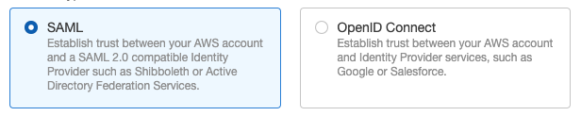
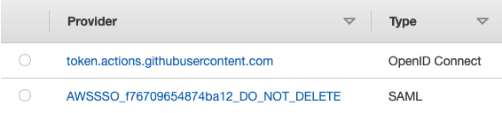
IAM - Identity Providers
Trust external Identity Providers (Google, Github, Okta, OneLogin, Active Directory…)
SAML & OAuth (OpenID) supported
Users from the external Identity Provider will be able to assume a role in AWS
Different roles could be trusting the same Identity Provider
Depending on the user privileges/groups of the third party platform, he will be assume one AWS role or the other
No way to give MFA based access to this users
MFA needs to be controlled in the trusted third party platform
https://t.me/CyberFreeCourses
From https://cloud.hacktricks.xyz/pentesting-cloud/aws-pentesting/aws-basic-information#identity-federation

Slide 11
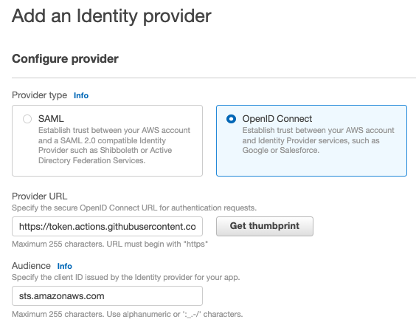

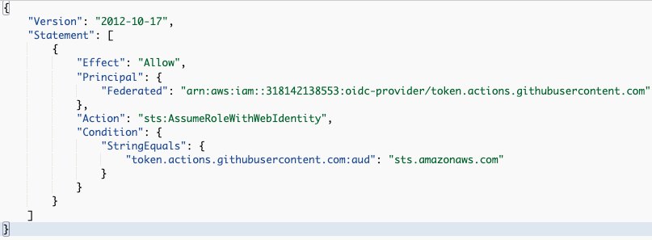
IAM - Identity Providers
DEMO
Create a Github Identity Provider Demo in: https://www.youtube.com/watch?v=3ocKVmXZZZY
https://t.me/CyberFreeCourses
https://cloud.hacktricks.xyz/pentesting-cloud/aws-pentesting/aws-basic-information#identity-federation

Slide 12
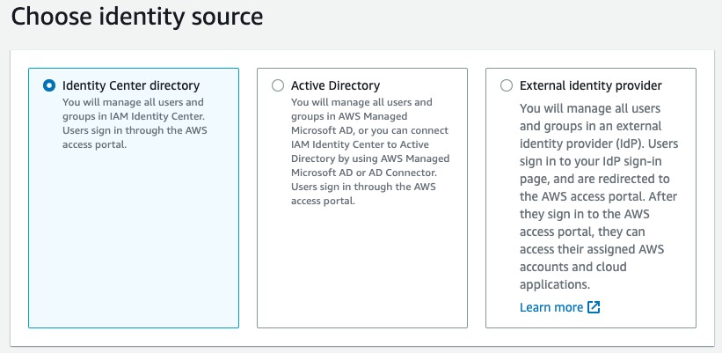
IAM - Identity Center
Central place that brings together administration of users and their access to AWS accounts and cloud applications.
Login domain is going to be something like <user_input>.awsapps.com.
To login users, there are 3 identity sources that can be used:
Identity Center Directory: Regular AWS users
Active Directory: Supports different connector
External Identity Provider: All users and groups comes from an external Identity Provider (IdP)
https://t.me/CyberFreeCourses
https://cloud.hacktricks.xyz/pentesting-cloud/aws-pentesting/aws-basic-information#iam-identity-center
Notes:
DEMO: Create a user and login into the Identity Center
https://eu-central-1.console.aws.amazon.com/singlesignon/home?region=eu-central-1#!/instances/69876aeb78c63efd/users$addUserWizardUse the one-time password and invent a email
add to group
https://testiamcenter.awsapps.com/start

Slide 13
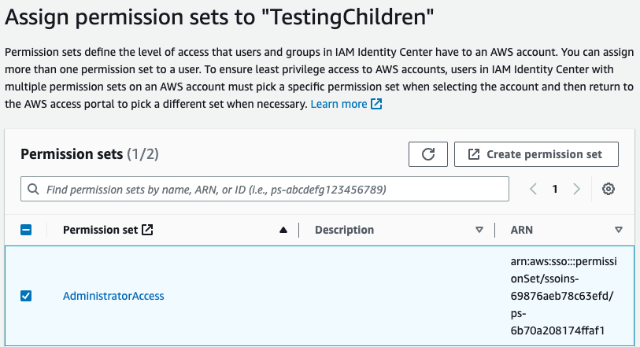


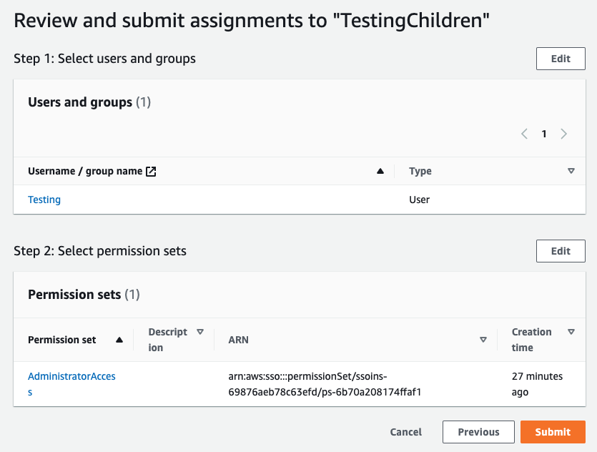
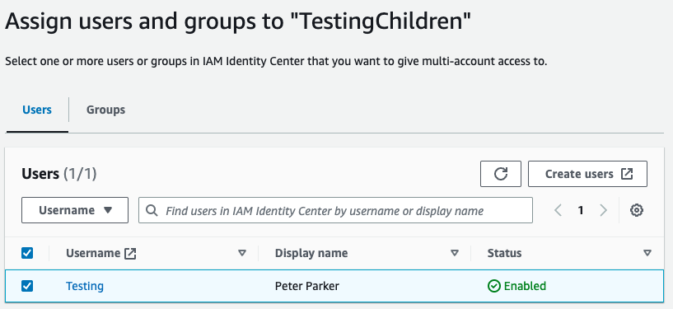
IAM - Identity Center
4- Select Permissions
1- Create User
2- Select Account to access
https://t.me/CyberFreeCourses
5- Review & Accept
3- Select User

Slide 14
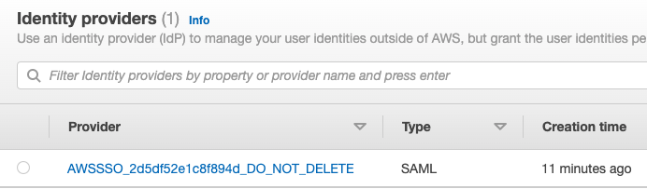
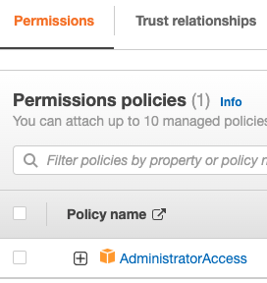
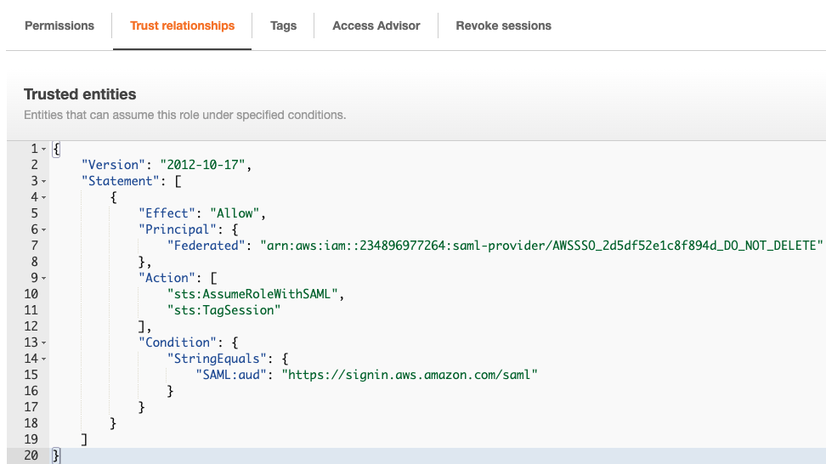
IAM - Identity Center
5.1- IdP is automatically generated
5.2- Role is generated
https://t.me/CyberFreeCourses

Slide 15
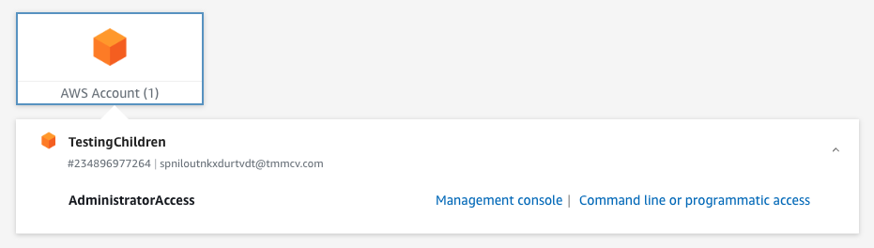
IAM - Identity Center
6- User can now login
https://t.me/CyberFreeCourses

